Slide 1
"consolidation of ties among African countries": …
.. Creating a sustainable network for information sharing”
HAQAA as a starting point for endless cooperation
Amany & Evelyn

Slide 2
Overview
On the same page?
Problem
Proposed solution
Barriers to success

Slide 3
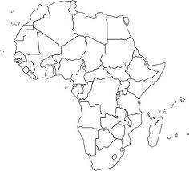
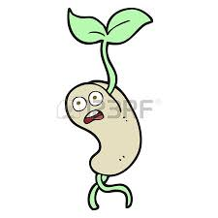
EC
AAU
Time
Raise awareness
Care
All partners
platform
HAQAA
Protection
Risk assessment
Notes:
We are African countries sharing, same land, same water, same sky.
Main partners, EC & AAU planted a seed in our land, its HAQAA initiative and they water it.
In order to allow it to germinate, We; African people are the ones who should pay care for it.
To allow it to grow and bloom.
Due to our diversity, the resulting tree will amazingly bloom with different flowers and fruits.
Our diversity is our strengths and our integration
But Be carful…
Three essential keys are needed to power this movement
1.time, so be patient, inform related community. Give them the information they can grasp& then you can have followers.
2. Care should be provided to the growing seed by all partners a: Us via the cooperation and net working on the plate-form
B: European Association for Quality Assurance in Higher Education (ENQA) , European University Association (EUA), University of Barcelona (Coordinator), German Academic Exchange Service (DAAD),
Finally We should offere protection by risk assessment and to recognize potential stake holders and how to manage them and define risk factors and overcome strategies

Slide 4
Problem
Below optimum performance of QAAs:
Unfamiliarity regarding other countries’ QAAs frameworks/approaches
Different stages of development of QAAs
Disparate systems/standards/processes
Limited cooperation & trust amongst QAAs
Poorly developed websites/communication channels

Slide 5
Problem
Lack of harmonization in higher education in different African Countries
Limited student & staff mobility
Sub-optimum use of resources due to limited sharing & exchange

Slide 6
Proposed solutions
Effective Networks of QAAs facilitate:
Dialogue & information sharing;
Sharing of resources
Capacity building;
Dissemination of good practice;
Cooperation & building trust

Slide 7
Proposed solutions
Establish an association for QA executive members all over Africa, e.g. AAQAA
- Consolidate mobility & exchange between African experts & European experts
- Provide decision makers with our vision and suggestions

Slide 8
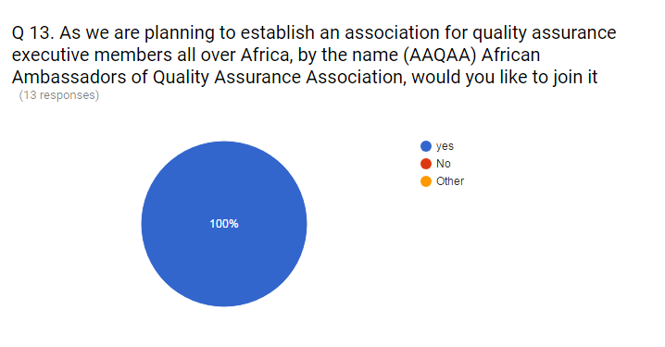
On-line questionnaire
If we are going to plan to establish an Association for quality Assurance executive members in agencies/ universities all over Africa, by the name AAQAA
Association of Ambassadors of Quality Assurance in Africa, would you like to join it????
Who says yes??

Slide 9
18 countries Say Yes
Africa
14. Tunisia
15. Burkina Faso
16. Burundi
17. CAR
18. Gabon
1. Egypt
2. Malawi
3. Zimbabwe
4. Kenya
5. Botswana
6. Uganda(2)
7. Nigeria
8. Namibia
9. Ghana
10. Liberia
11. Mozambique
12. South Africa
13. Tanzania
Morocco
Tunisia
Western Sahara
Algeria
Libya
Egypt
Mauritania
Mali
Niger
Sudan
Senegal
Burkina Faso
Chad
Somalia
Guinea
Nigeria
South Sudan
Sierra Leone
Liberia
Central African Republic
Ethiopia
Ghana
Cameroon
Republic of Congo
Uganda
Gabon
Democratic Republic of Congo
Kenya
Tanzania
Angola
Zambia
Mozambique
Namibia
Botswana
Zimbabwe
Madagascar
South Africa

Slide 10
Barriers to successful networking
Absence of formal MoUs;
Legislative & policy restrictions e.g. confidentiality & IP
Language & cultural constraints
Plagiarism (or fear of it)
Human resources turnover in QAAs
Building trust takes time, dedication & resources

Slide 11
Barriers to successful networking
Difficulties in communication
Sustainability of the Association
Funding/ Budget
Setting working rules & regulations approved by all members
Determining the authorities & selecting the Board
Membership structure

Slide 12
Our Question is….
Can
be a starting point for endless cooperation between all stick holders?
In other words….
Can we cross the barriers?

Slide 13
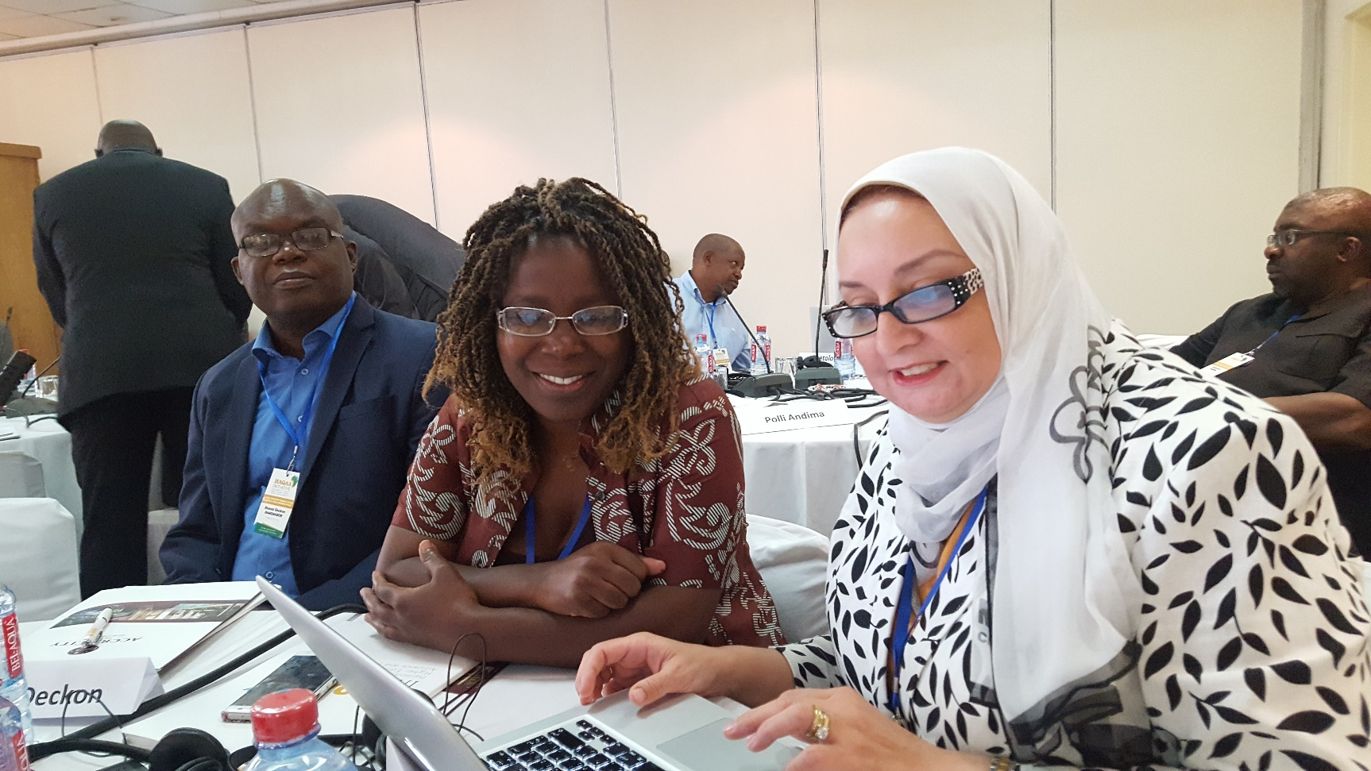
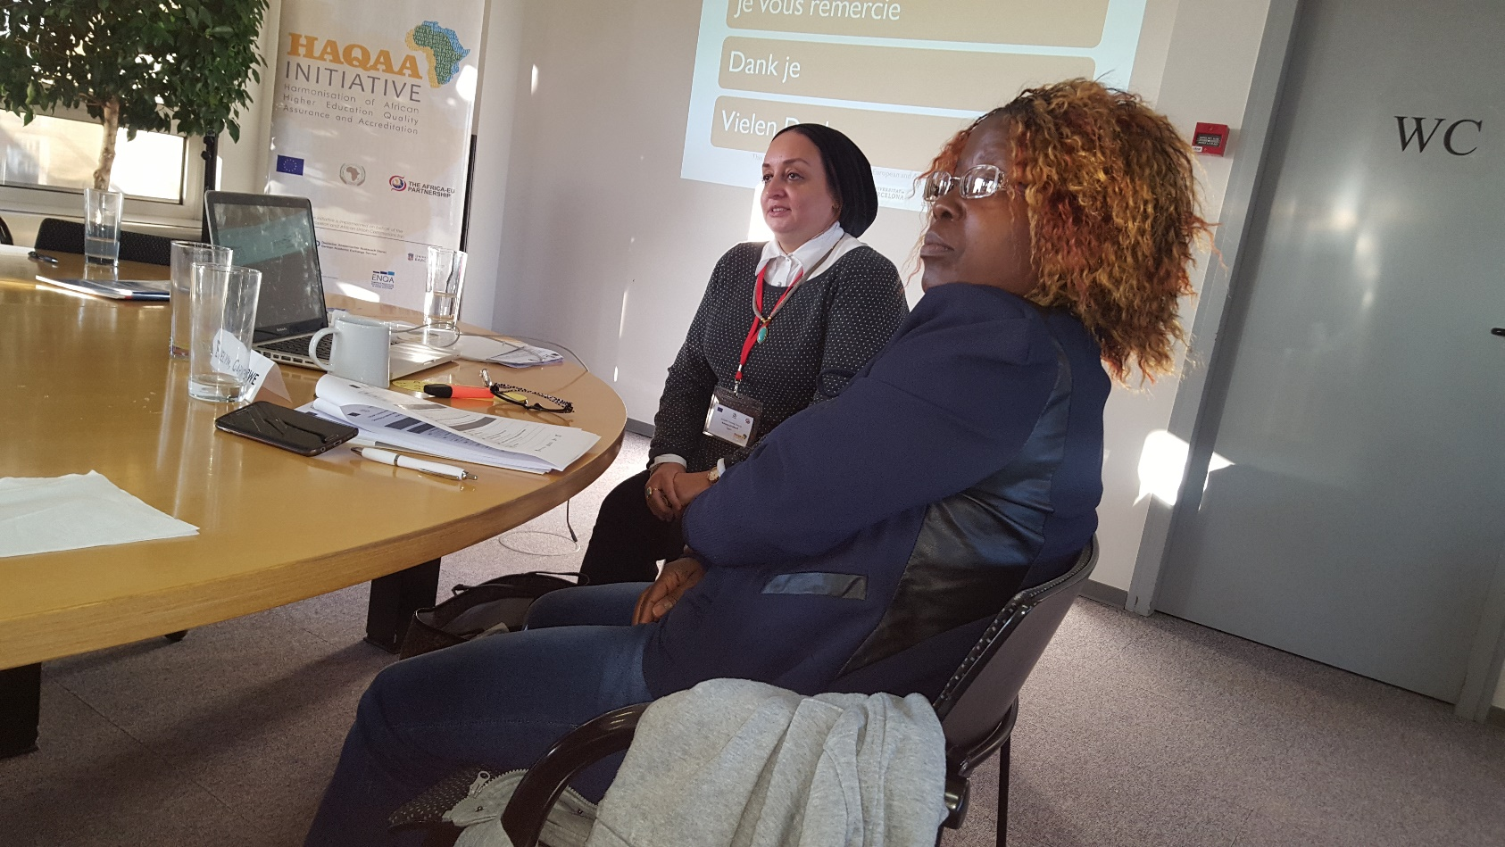
We’ve already started

Slide 14
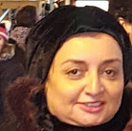
Thank you
&
Evelyn
Amany

