Slide 1
Brief update on the ESG and their present use in the EHEA
Caty Duykaerts
Vice-President, ENQA
CEO, AEQES

Slide 2
ESG – Key milestones
2000 ENQA was established as the European Network for Quality Assurance in Higher Education
Berlin Communiqué 2003 called upon ENQA, in co-operation with the EUA, EURASHE and ESU to develop an agreed set of standards, procedures and guidelines on quality assurance, and to explore ways of ensuring an adequate peer review system for quality assurance agencies
2004 ENQA was transformed into the European Association for Quality Assurance in Higher Education
2005 Bergen Ministerial conference:
adopted the Standards and Guidelines for Quality Assurance in the European Higher Education Area (ESG) (developed with E4 partners)
endorsed the proposal to create a European register of QA agencies
accepted ENQA as consultative member in the Bologna follow-up Group
2008 the European Quality Assurance Register for Higher Education (EQAR) was established, with the E4 as founders and members of the Executive Board
Notes:
ENQA was established in 2000 as the European Network for Quality Assurance in Higher Education, in response to calls by the Council of the European Union and the 1999 Bologna Declaration, which started the Bologna Process, for increased pan-European cooperation in the QA of HE (The Finnish Higher Education Evaluation Council (FINHEEC) hosted the Secretariat. )
At the time ENQA’s activities were to a large extent directed at promoting exchange of information and good practice through newsletters, its website, series of training workshops and
conferences, and the sponsorship and publication of thematic research. However it immediately started to play an active and more political role in moving forward the Bologna goals on quality
assurance.
Indeed the history of ENQA is strictly intertwined with that of the Bologna Process. One of the key events influencing the development of ENQA and European QA, is represented by the 2003 Bologna Conference in Berlin where the Ministers, in their final communique called upon ENQA, in co-operation with the EUA, EURASHE and ESU, ‘to develop an agreed set of standards, procedures and guidelines on quality assurance, and to explore ways of ensuring an adequate peer review system for quality assurance and/or accreditation agencies or bodies.’
By then ENQA, EUA , EUASHE and ESU had formed an informal group of stakeholders with an interest in the quality of teaching and learning in HE, known as the E4- and cooperation with these and others stakeholders characterise to these days the work of ENQA {NOTE: EURASHE stands for ‘the European Association of Institutions in Higher Education’, these are institutions that offer professionally-orientated programmes}
Following the Berlin conference, the ministers mandate the E4 group, under the leadership of ENQA, to develop the “Standards and Guidelines for Quality Assurance in the EHEA” (ESG), which were presented to and adopted by the ministers at the 2005 Bergen Conference,
The Education Ministers in Bergen also welcomed another proposal submitted by the E4 group, that of establishing a ‘European register of quality assurance agencies’, asking ENQA to develop, working with its E4 partners, the practicalities of its implementation
Significantly, at the 2005 Bologna conference ENQA was also accepted as a consultative member of the Bologna Follow-Up Group, the key follow-up structure overseeing the Bologna Process between the ministerial meetings. Thus formalising and strengthening ENQA’s role in the political decision-making process in European Quality Assurance
In the meantime in 2004 the Network had been transformed into an association, under the new name the European Association for Quality Assurance in Higher Education (ENQA), precisely to give itself a more formal structure to better organise internal decision making, and better perform its acquired role as a voice of European quality assurance agencies.
After the Bergen Ministerial conference, ENQA worked hard to introduce the ESG and to develop the EQAR, which was eventually established as an independent organisation in 2008, after the operational model proposed by the E4 was endorsed by the Ministers at the Bologna summit in London 2007.
What the Ministers committed to in endorsing the EQAR was in effect to open up the national higher education systems to the services of non-national quality assurance agencies, therefore facilitating the development of an external QA market in the EHEA. EQAR can be considered as the institutional component of such as quality assurance market in the EHEA.

Slide 3
ESG 2015 – Key milestones
2010
Budapest-Vienna ministerial conference
2012
Bucharest communiqué: mandate to E4 group + EI, BusinessEurope and EQAR
May 2015
Yerevan Ministerial conference
Notes:
In 2010 the E4 Group, launched the “Mapping the Implementation and Application of the Standards and Guidelines for Quality Assurance in the European Higher Education Area (MAP-ESG)” project in order to gather information on how the ESG had been implemented and applied in the 47 Bologna signatory countries in higher education institutions and in quality assurance institutions, and to launch a thorough discussion on the ESG in their entirety. In doing so the E4 Group responded to a discussion which has gained momentum since 2009 and which suggested that there should be a review of the ESG.
In order to ensure wider involvement of other stakeholders, the project was assisted by an Advisory Board, consisting of EQAR, Business Europe, Education International and government representatives identified by the BFUG.
That report was given to the Ministers of education at the Budapest-Vienna conference of 2010. What were the main findings and recommandations of the report?
1. the ESG had proved to be a major achievement of the Bologna Process – they are well-regarded by all stakeholders, have proved to be applicable across diverse contexts, have impacted
on the development of QA processes at institutional and national level and on the work and review of quality assurance agencies (QAAs). They have facilitated a shared understanding of QA amongst the relevant stakeholders and actors in HE. QA, whether internal or external, is conducted across the EHEA according to the framework of principles they provide. They constitute a crucial means for achieving the goals of the Bologna Process.
2. The following conclusions were reached:
Purpose and Scope: it was generally concluded that it is essential to maintain the concept of the generic principle in order to ensure the continuing relevance of the ESG to all relevant stakeholders in the EHEA and to maintain their authority as the common reference point for QA in the EHEA. A tension regarding the purpose of the ESG was raised: that of their role as a reference document as opposed to that of a compliance tool. The current scope is deemed to be generally appropriate but there is encouragement to reflect on the extent to which a revised ESG document should link to specific Bologna commitments and reflect overarching principles agreed among the Bologna signatories.
Clarity and Usability: it is clear that the document could be improved by some further work to increase clarity of terminology and to ensure the removal of ambiguity both in terms of the language used and also with regard to the standards and guidelines themselves to ensure that they are as clear as possible.
Implementation and Impact: there is clear evidence that the ESG have been widely implemented and have impacted significantly on QA in the EHEA. However, further work could be done to raise awareness and ownership of the ESG even further, particularly amongst faculty staff directly involved in the student learning and teaching process.
The conclusions of the project, therefore, focus on the improvement of the ESG as they are currently formulated rather than recommending a wholesale revision of the content of the principles enshrined in the document.
In 2012, the Bucharest communiqué invited the E4 group in cooperation with EI (Education international), Business Europe and Eqar to « prepare an initial proposal for a revised ESG « to improve their clarity, applicability and usefulness, including their scope »
The revision included several consultation rounds involving both the key stakeholder organisations and ministries; the many comments, proposals and recommendations were analysed and taken into consideration by the steering group into the final version.
The document was adopted by the ministries responsible for HE in May 2015.

Slide 4
Points importants à retenir de ce bref historique
À la fois en termes de processus et du document lui-même:
Diagnostic, réflexivité, boucle qualité (portée, usage, finalités, impact, clarté et terminologie)
Prise en compte des évolutions du contexte de l’enseignement supérieur
Importance de la consultation (valeurs démocratiques, mais aussi nécessité de sensibilisation aux et appropriation des ESG)
Approche participative et coopérative: élargissement à trois organisations supplémentaires: enseignants, monde professionnel, registre EQAR
Mise en place d’un monitoring des ESG
Notes:
Ce bref retour en arrière sur les années qui ont précédé l’adoption des ESG, version 2015 permet de souligner quelques éléments importants:
Les parties prenantes ont démontré une capacité de diagnostic et de réflexivité – en quelque sorte, elle respectent la boucle qualité! Elles ont traité les divers aspects des ESG: leur portée, usage, leurs finalités, mesure d’impact et aussi la nécessité d’être attentif à la clarté des propos et à la terminologie employée
La révision est une évolution, non une révolution, mai elle prend en compte l’évolution rapide du contexte de l’enseignement supérieur: diversité accrue des publics étudiants et accroissement de leurs demandes, ce qui a induit une évolution de paradigme vers l’apprentissage centré sur l’étudiant, l’apprenant (accent mis sur learning and teaching) notamment.
En termes de processus, il faut aussi souligner l’importance de la consultation: non seulement, cette consultation fait vivre les valeurs démocratiques qui sont précieuses, mais elle répond simultanément à la nécessaire sensibilisation des PP aux ESG et à leur indispensable appropriation – c’est un gage de succès pour la mise en oeuvre des ESG
Je vous félicite de prévoir – comme le présent séminaire s’y emploie – une phase de consultation dès la première version des ASG…
Intéressant aussi de noter l’élargissement de l’approche participative et coopérative: au-delà du groupe des 4E, et des ministres, d’autres organismes ont été associés à la réflexion
Enfin, toujours en termes de processus, je terminerai par souligner la modalité de monitoring des ESG, version 2015 qui a été mise en place à travers le projet EQUIP

Slide 5
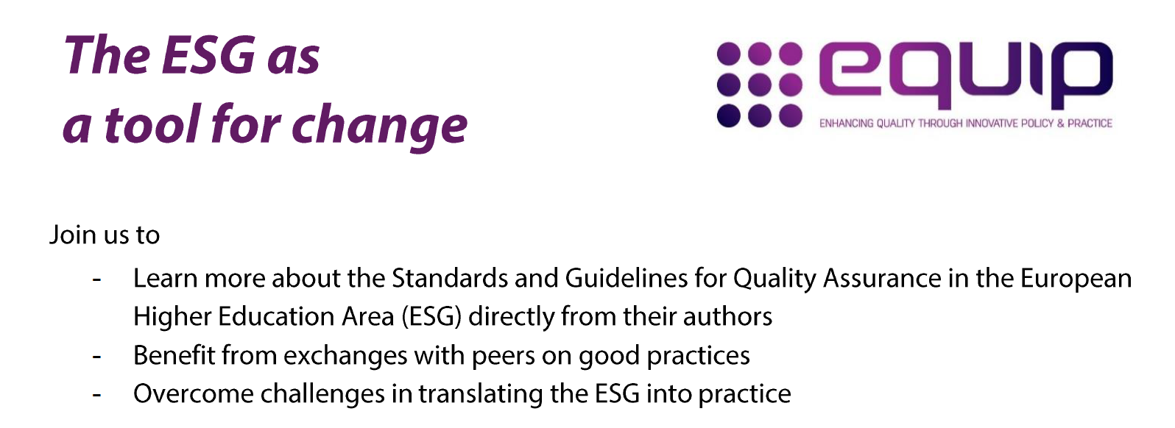
En cours: le projet EQUIP (Enhacing Quality through Innovative Policy & Practices)
Objectif
soutenir et promouvoir une appropriation efficace, cohérente et innovante des ESG par ses « utilisateurs de base »: identifier les défis et coopérer (notamment avec les décideurs politiques) pour proposer, partager et discuter de l’applicabilité des ESG
Partenaires
groupe E4, EI, BE, Eqar
Université d’Oslo
Conseil de coordination des
instituts supérieurs poly-
techniques du Portugal
Notes:
Le travail ne s’arête pas à l’écriture de référentiels et à l’élaboration de dispositifs
Un travail spécifique pour accompagner la mise en œuvre est gage de réussite

Slide 6
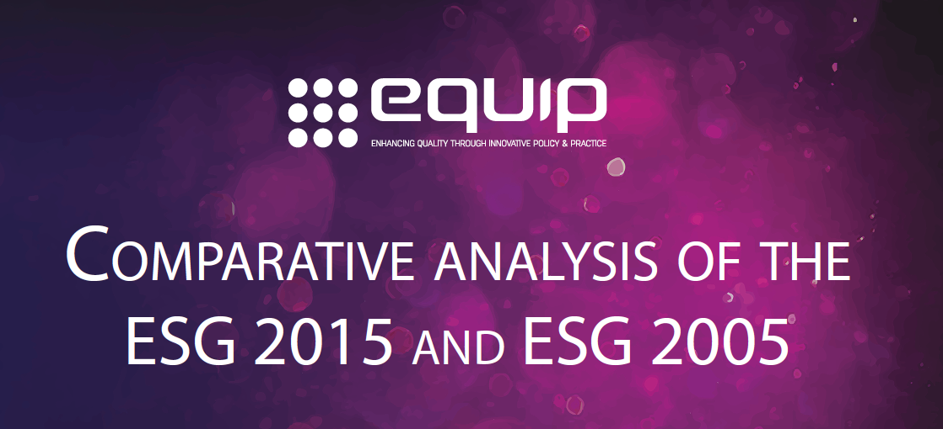
En cours: le projet EQUIP
Activités et résultats
- Organisation de webinars et ateliers (voir site du projet)
- Rapport analytique soulignant
les innovations des ESG 2015
- Promotion des ESG
- Large enquête auprès des
acteurs de l’ES
- Collecte de bonnes pratiques
- Étude sur les défis de mise en œuvre, les solutions proposées et impact (publication fin 2017)
- Propositions de recommandations à destination des Ministres pour la Conférence ministérielle de 2018 (Paris, 23-25 mai)
Voir http://www.equip-project.eu/
Notes:
Les webinars et ateliers gratuits se sont déroulés de février à juin 2016 (Amsterdam, Vienne et Lisbonne) et les acteurs directement impliqués dans la révision des ESG ont traités des questions comme:
- comment l’AQE sera impactée par les ESG 2015?
Comment comprendre le concept d’apprentissage centré sur l’étudiant?
Quels sont les implications du nouvel accent mis au sein des ESG sur « learning & teaching »?
Etc.
Rapport analytique et comparatif 2005 vs 2015
De manière générale, promotion des ESG (sous diverses formes): large enquête auprès des acteurs de l’ES, collecte de BP
L’étude dont la publication est prévue fin 2017, examinera les impacts que la révision des ESG aura eu sur les principales parties prenantes, les adaptations de leurs pratiques afin d’être conformes aux nouveaux éléments des ESG et des approches innovantes à imaginer pour gérer les nouveaux défis.
L’étude sera enrichie des témoignages collectés au cours des différentes activités (webinars, focus groups, séminaires, ateliers, enquêtes) et se conclura avec des recommandations pour chaque catégories de PP dans l’amélioration de la qualité de l’ES à travers l’usage des ESG.
Enfin, la dernière activité de ce projet consistera en la formulation à l’attention des décideurs politiques de recommandations en faveur de la qualité et de la compétitivité de l’ES. Ce texte est prévu pour début 2018 afin d’influencer l’élaboration du communiqué de la conférence ministérielle de Paris.

Slide 7
Thank you! Merci!

